Slide 1
CONTENTS
Introduction
Research Objectives
Methodology
Literature Review
Discussion
Results and Recommendations
Proposed Solution and Conclusion

Slide 2
INTRODUCTION

Slide 3
INTRODUCTION
Problem Statement
Purpose and Scope
The core problem this report addresses is the significant healthcare disparities in maternal care within rural communities. These disparities lead to adverse outcomes, such as increased infant mortality rates and heightened instances of postpartum depression. Our goal is to use telemedicine to alleviate these issues.
This report aims to provide a comprehensive analysis of maternal healthcare disparities in rural communities and evaluate the potential of telemedicine as a solution. The report's scope includes examining the current state of maternal healthcare in rural areas, assessing the viability of telemedicine solutions, and exploring the role of advanced technologies like AI and AR as well as cost effective technologies.

Slide 4
Research Objectives
Evaluate the Extent and Nature of Maternal Healthcare Disparities in Rural Communities: Understanding the specific challenges and barriers faced in providing maternal care in rural settings.
Assess the Feasibility of Implementing Telemedicine Solutions for Maternal Care in Rural Areas: Exploring the technical, logistical, and financial aspects of deploying telemedicine in these settings.
Assess the Role of Relevant Technologies in eHealth Initiatives Targeting Perinatal Care: Investigating how technologies such as AI and AR can be integrated into telemedicine solutions to enhance the quality and accessibility of maternal healthcare.
Understand the Perceptions and Acceptance of Telemedicine for Maternal Care Among Rural Residents: Gauging the willingness of the rural populace to adopt telemedicine solutions and identifying potential barriers to acceptance.
Determine the Potential Impact of Telemedicine on Improving Maternal and Infant Health Outcomes in Rural Communities: Predicting the efficacy of telemedicine solutions in improving health outcomes for mothers and infants in rural areas.

Slide 5
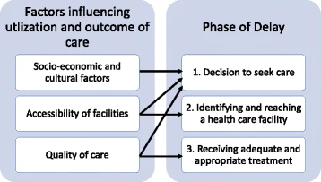
Methodology
Three Delays Model

Slide 6
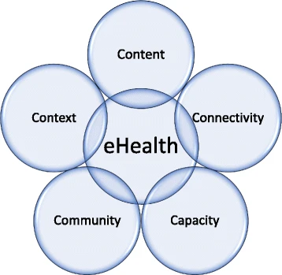
Methodology
5C Model
●Content: The accuracy, relevance, and comprehensiveness of the healthcare information provided by the eHealth solution. This includes medical data, educational content, and user-specific information tailored to meet the needs of the target population.
●Connectivity: The quality and reliability of the technology and infrastructure that provide access to eHealth services. This includes internet access, telecommunications networks, and the interoperability of systems that allow for efficient data exchange and communication.
●Capacity: The ability of the healthcare system, including its workforce, to support and sustain eHealth initiatives. This covers not only the technical skills of healthcare providers but also the organizational capacity to adapt to new technologies and procedures.

Slide 7
Methodology
5C Model
●Community: The engagement and involvement of the target population with the eHealth solution. Community here encompasses the end-users who can be patients, healthcare providers, or other stakeholders, and their willingness to adopt and integrate eHealth into their daily practices.
●Culture: The beliefs, behaviors, and social norms that influence the acceptance and use of eHealth. This includes considerations of language, health literacy, attitudes towards technology, and trust in eHealth services.

Slide 8
Literature Review

Slide 9
National Rural Health Mission and ASHA
Persistent Global Targets:
In developing nations, robust Maternal, Neonatal, and Child Health (MNCH) services are critical to mitigate high mortality rates.
Challenges in UP:
Uttar Pradesh faces challenges with low coverage of key MNCH services, hindering progress towards global health targets.
ASHAs and NRHM Initiative:
The National Rural Health Mission (NRHM) introduced Accredited Social Health Activists (ASHAs) to boost MNCH service coverage through community mobilization.
mHealth Integration for Rural Service Improvement:
Integrating mobile technology (mHealth) with community health worker training offers a sustainable approach to enhance MNCH service delivery in rural areas.

Slide 10
The Role of mHealth in Enhancing MNCH Services
ImTeCHO in Gujarat:
Mobile app boosted ASHA performance, offering supervision, support, and motivation, enhancing maternal healthcare in Gujarat, India.
ReMiND in UP:
CommCare m-health aided ASHAs in Kaushambi, UP, improving antenatal attendance and skilled deliveries, positively impacting maternal and neonatal outcomes.
mHealth as Job Aid:
Mobile applications empower ASHAs with job aids, support, and real-time supervision, enhancing overall community health worker performance.
Replicability and Scalability:
Successful mHealth interventions, like ImTeCHO and ReMiND, demonstrate potential for scalability and replication in diverse healthcare settings.

Slide 11
Impact and Cost-Effectiveness of mHealth Interventions
Impact and Cost-Effectiveness of mHealth:
Studies assess mHealth interventions' impact on MNCH services, comparing outcomes and cost-effectiveness with routine service delivery. For instance, the ReMiND project enhanced ASHA performance.
Challenges in Implementing mHealth:
Despite potential benefits, mHealth faces challenges such as non-random allocation, intervention area selection, and limitations in blinding participants.
Broader Impact of mHealth Applications:
While mHealth applications were initially designed for specific objectives, their broader impact on postnatal care and neonatal morbidity requires consideration.
Telehealth in Maternal Care - Post COVID-19:
The literature reviews telehealth impact on maternal health outcomes during COVID-19, revealing promising results but emphasizing the need for further exploration of disparities and potential harms.

Slide 12
Discussion

Slide 13
Telemedicine
Challenges
Internet Connectivity.
Privacy And Security Of Patient Information.
limited computer literacy among users.
Cultural and Social Factor.

Slide 14
Telemedicine
Solution to:
Accessibility
Emergency and Critical Situations
Prevention Care

Slide 15
Technological innovations
Machine Learning
analyzing medical imaging, like ultrasound scans, with precision, aiding in early detection of complications.
contributes to the early diagnosis of congenital anomalies during pregnancy.

Slide 16
Technological innovations
VIRTUAL/AUGMENTED REALITY
VR/AR enhances rural healthcare workforce skills.
VR/AR empowers understanding, bridging knowledge gaps in prenatal care

Slide 17





Feasibility Analysis
Strategies for Effective Implementation
Infrastructure and Technology Development
Training and Support
Customized Telemedicine Solutions
Policy and Regulatory Framework
Adequate Awareness

Slide 18
GLOBAL CURRENCY MARKETS
 | $USD | £EUR | ¥JPY | ₿BTC
Q1 | 4.5 | 2.3 | 1.7 | 5.0
Q2 | 3.2 | 5.1 | 4.4 | 3.0
Q3 | 2.1 | 1.7 | 2.5 | 2.8
Q4 | 4.5 | 2.2 | 1.7 | 7.0

Slide 19
WEALTH IS THE ABILITY TO FULLY EXPERIENCE LIFE.
-Henry David Thoreau

Slide 20
TYPES OF TOKENS
Payment
Utility
Security
NFT
Gaming
Used to complete transactions anywhere crypto is accepted
These tokens have a specific use within a blockchain
Tokens backed by securities
Authenticates ownership of specific assets
Used as in-game currency and traded with real world value

Slide 21
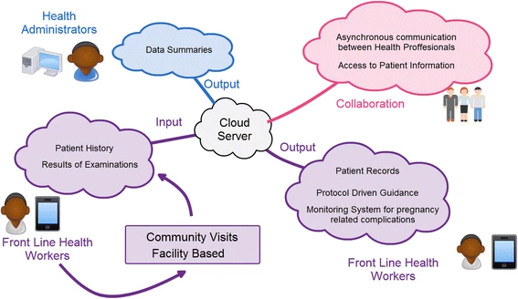
Proposed Solution
Application for Android mobile phones or tablets, designed for frontline health workers in Community-based Health Planning and Services (CHPS) zones
It operates on a cloud-based platform, leveraging available mobile communication networks in healthcare facilities.
Primary focus of this solution is to provide a pregnancy monitoring system and to bridge the gap between healthcare facilities and communities

Slide 22
Proposed Solution
Application should include decision support systems and data collection services
Application should include decision support systems and data collection services
The application would enable healthcare facilities to share information more effectively, improving patient tracking and collaboration among healthcare professionals

Slide 24
THANK YOU
Mirjam Nilsson​
mirjam@greatsiteaddress.com
www.greatsiteaddress.com

